Slide 1
The New Modelica MultiBody Library
Martin Otter
Deutsches Zentrum für Luft- und Raumfahrt (DLR)
Institut für Robotik und Mechatronik (www.robotic.dlr.de)
DLR Oberpfaffenhofen, July 18, 2003
Abstract:
The MultiBody library is a beta-release. It will be finally released and will be included in the Modelica Standard Library in Mid of September 2003.
This library will replace the long used ModelicaAdditions.MultiBody, since it is much more convenient to used and more powerful. On the following slides an overview of the most important features is given.

Slide 2
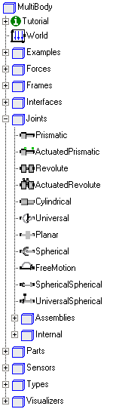
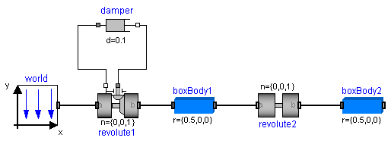
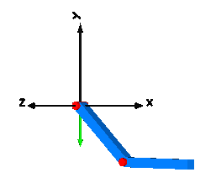
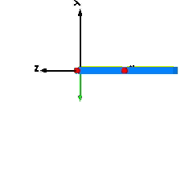
1. Default Animation
All components have built-in animation properties allowing an easy visual check of the model. Animation of every component can be switched off via a parameter or globally. Example:

Slide 3
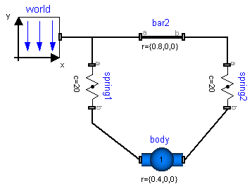
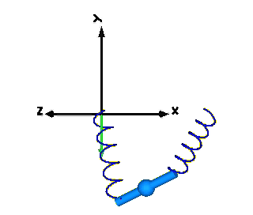
2. Automatic state selection from joints and bodies
Both joints and bodies have potential states. Dymola tries to use the generalized coordinates of joints as states. If this is not possible, states are selected from body coordinates. An advanced user may select states manually from a menu.
Since this system has no joints,
Dymola automatically selects body coordinates as states.

Slide 4
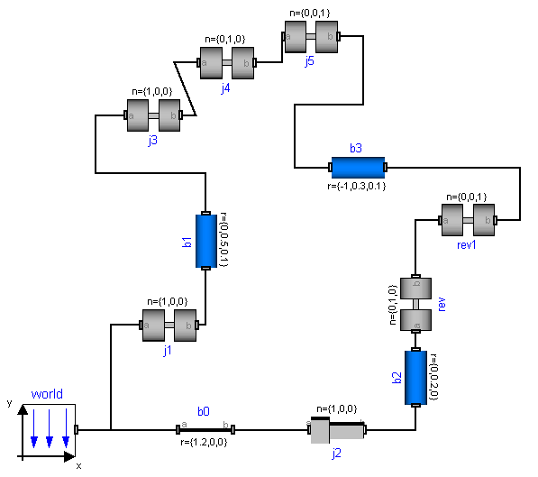
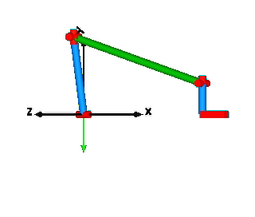
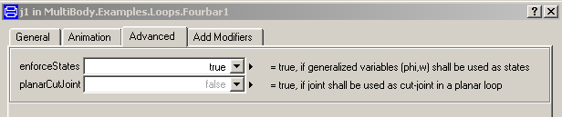
3. Automatic handling of kinematic loops
Kinematic loops are handled automatically, i.e., the user does not have to think about cut-joints or has to select states in a loop (an advanced user may select the state variables; based on new theory to handle a certain class of overdetermined DAEs)
Example: Four-bar mechanism with
6 revolute and 1 prismatic joints

Slide 5
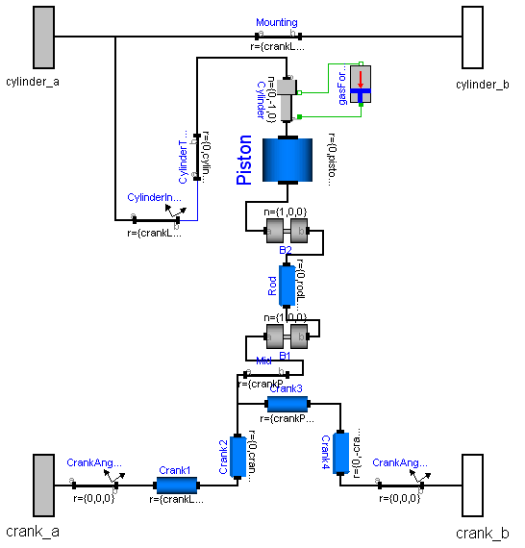
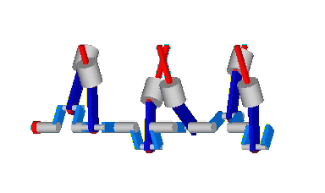
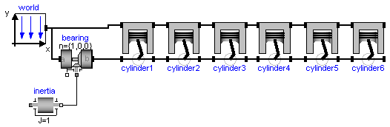
Loops can be hierarchically composed
together. Example: V6 engine

Slide 6
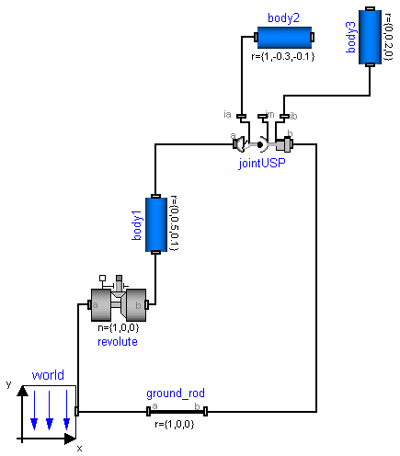
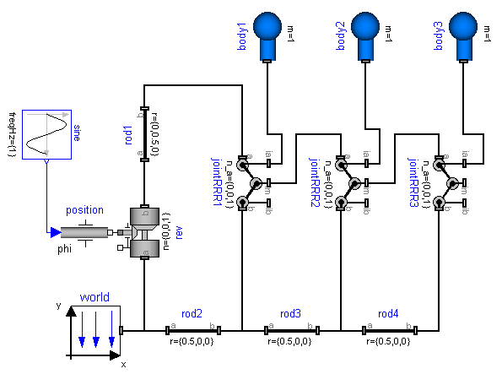
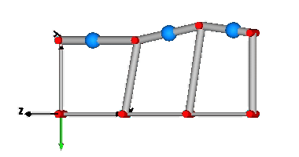
4. Analytic solution of non-linear equations in kinematic loops
Non-linear equations occurring in kinematic loops are solved analytically for a large class of mechanisms, such as 4 bar, slider-crank, MacPherson. Based on theory of Woernle/Hiller, using joint aggregations of 3 joints that have together 6 degrees of freedom, i.e., no constraints, e.g., Universal – Spherical – Prismatic
Four-bar mechanism with
1 revolute and 1 JointUSP
JointRRR

Slide 7
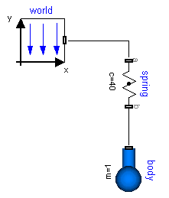
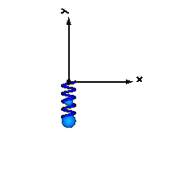
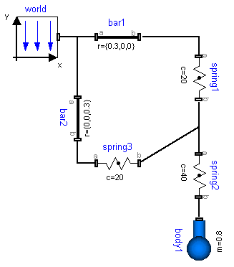
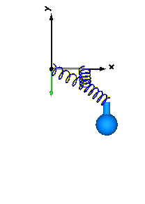
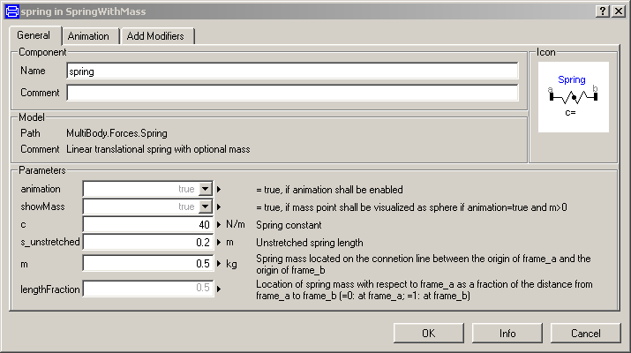
5. Force elements may have mass and can be connected arbitrarily
force elements may have mass
(small loops are solved analytically)
series connection of force elements,

